Slide 1
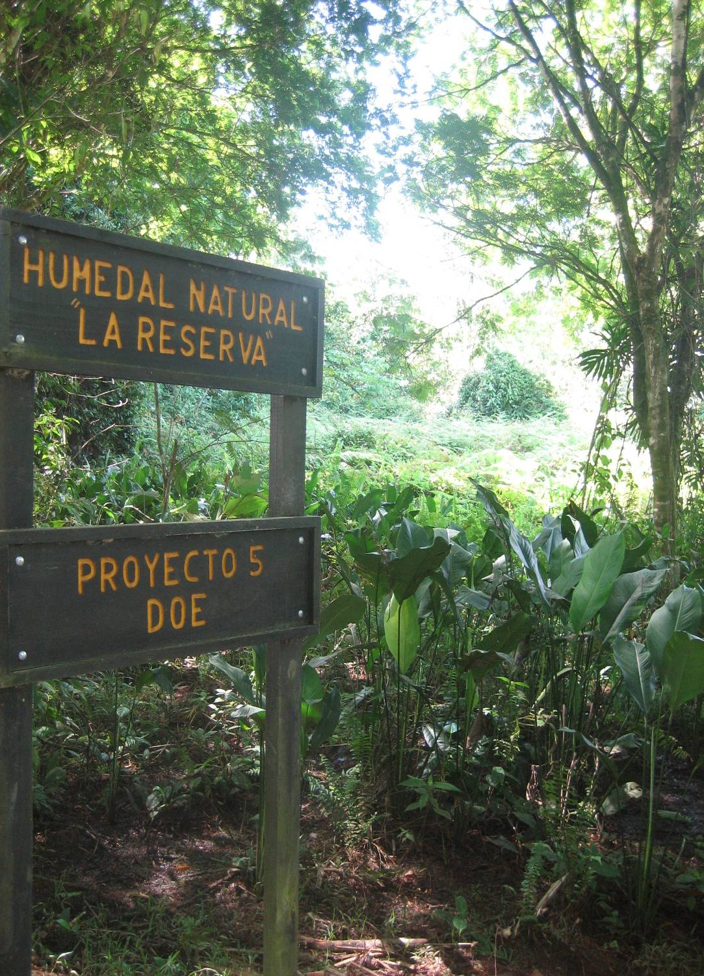



Water Balance, Seasonal Hydroperiod Variation and Time of Residence of a Small Natural Freshwater Wetlands in the Humid Tropics in Costa Rica
M. Bachelin (M.Sc.) R. Muñoz-Carpena
D. Kaplan (Ph.D.) A. Rinaldo

Slide 2
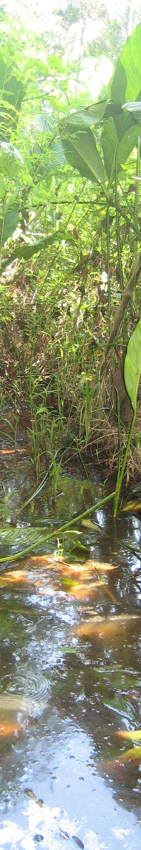
Acknowledgments:
Funding: UF Gatorade Foundation, Dr. Win Phillips
EARTH cooperators: Warner Rodriguez, Julio Tejada, Faelen Koln and Maria Floridalma Miguel
USDA-ARS: Dr. Thomas Potter
UF: Paul Lane, Dr. Bin Gao Dr. Timothy G. Townsend, Dr. Hwidong Kim,
For more info, contact : carpena@ufl.edu

Slide 3
Outline
Motivation
Part 1 : Field study
  1.1 Introduction, motivation and objectives
  1.2 Material and methods
  1.3 Results:
    1.3.1 Water stages
    1.3.2 Water budget
    1.3.3 Model of the water volume and area
    1.3.4 Water quality information
    1.3.5 Comparison of the volume
  1.4 Conclusions
Summary and Take Home
Part 2 : Tracer study
  2.1 Introduction, motivation and objectives
  2.2 Material and methods
  2.3 Results
    2.3.1 Bromide concentration
    2.3.2 Velocities and preferential chanels
    2.3.3 Br - comparison with SF6
  2.4 Conclusions

Slide 4
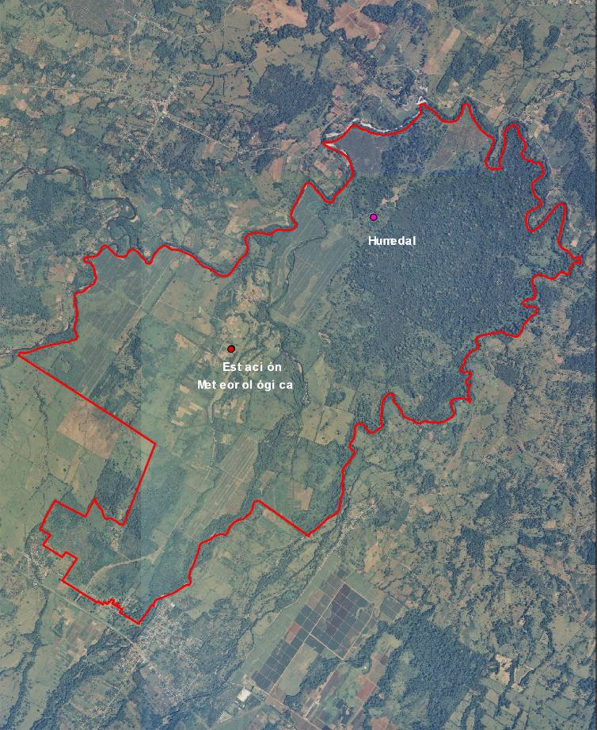

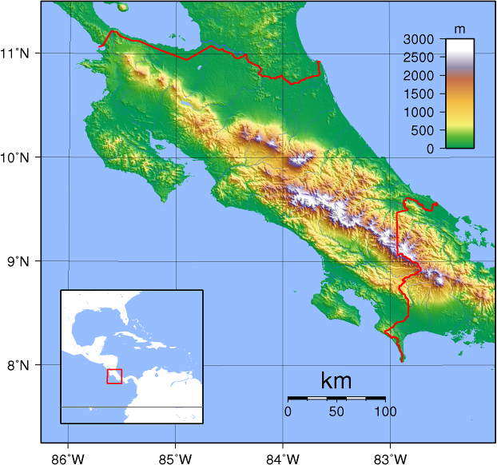
Location of the wetland in EARTH University Campus, Limon province, Costa Rica
Collaboration Project:
  UF and EARTH University
Nicaragua
1km
Costa Rica
Location of study wetland area
Panama

Slide 5
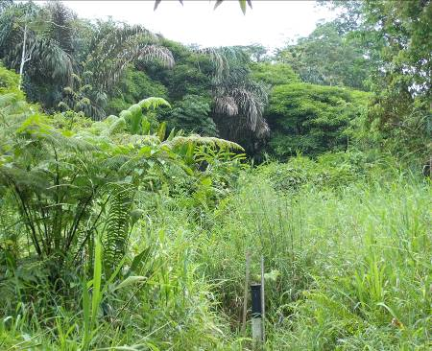
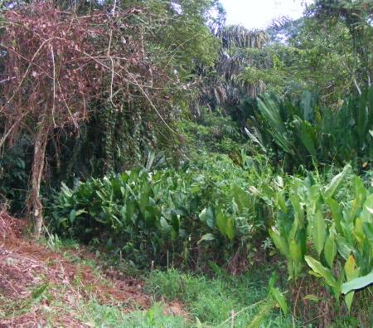
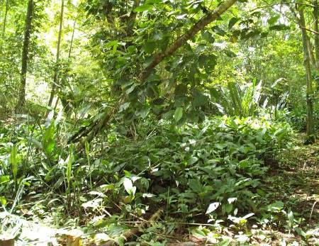
Why this wetland ?
Tropical natural freshwater wetland
  Less studied than temperate ones
  Inventory/hydrological studies focused on large systems
  Abundance and ubiquitous distribution of small wetlands in the tropics of Central America
  Generation of information on hydrology support public decision-making to maintain its sustainability
“La Reserva” wetland
  Single regulated outlet
  No specific inlet
  Small area (9 ha)
Notes:
Tropical wetlands are less studied than temperate wetlands
importance of their environmental functions (water storage, flood control and water quality improvement…)
Tropical Natural freshwater wetland
Inventory/hydrological studies of natural tropical wetlands have been focused mainly on large systems
abundance and ubiquitous distribution of small wetlands in the tropical landscape of Central America
generation of information on hydrology support public decision-making to maintain its sustainability.
Our hypothesis is that the abundance and ubiquitous distribution of small wetlands in the tropical landscape of Central America reinforce the importance of their environmental functions (water storage, flood control and water quality improvement). In that sense, the present case study of a small wetland with no inlet and a regulated outlet will help to focus actions of investigation around the generation of information on hydrology to support public decision-making to maintain its sustainability.
“La Reserva” wetland
Single regulated outlet
No specific inlet
Small area (9 ha)

Slide 6
1.1 Objectives of the study
Evaluate the spatially and temporally complex and dynamic hydrology of a natural wetland in the humid tropics of the Atlantic region of Costa Rica :
  Quantify and analyse the key components in the water balance;
  Identify hydroperiod frequency and inter-annual water surface and storage variation during one year of water stages monitoring;
  Assess the stability of the hydrologic response of the wetland as an indicator of predominant wet and dry trends through the year and natural water quality function potential.
Notes:
Evaluate the spatially and temporally complex and dynamic hydrology of a natural wetland in the humid Tropics of the Atlantic region of Costa Rica
Quantify and analyse the key components in the water balance
Identify hydroperiod frequency and inter-annual water surface and storage variation during one year of water stages monitoring
Assess the stability of the hydrologic response of the wetland as an indicator of predominant wet and dry trends through the year and natural water quality function potential.

Slide 7
1.2 Material and Methods

Slide 8
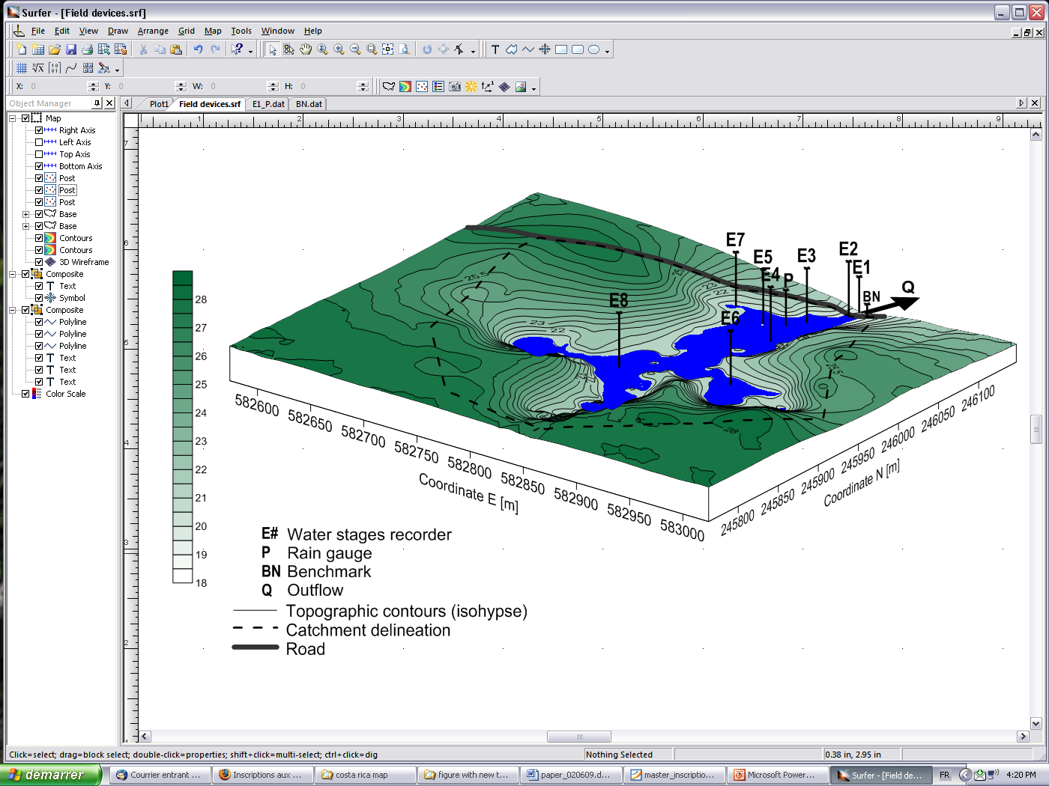
1.2.1 Instrument location in the wetland
Field work May 2008
  Network of automatic field devices
  Surface water tracers (Br⁻, SF₆)
  Topographical Survey
  R. Muñoz-Carpena, D. Kaplan, P. Lane
  J. Tejada, F. Kolln
Field work May 2009:
  New water level station
  Topographical Survey
  Runoff plots
  R. Muñoz-Carpena, P. Lane, M. Bachelin
  W. Rodriguez, F. Ros

Slide 9
Water stage recorder
Selection: simplicity, easy maintenance, high accuracy and low cost (Schumann and Muñoz–Carpena, 2002)
Very simple to install and manage (important in harsh field conditions, annual precip.=4500 mm)
All components (potentiometer, pulley, floats and datalogger) inside a PVC pipe
Data logger converts the analog signal from the potentiometer to a digital signal:
  Resolution : 0.78 cm per step
  Step : every 15 minutes
Water elevation is calculated by knowing the sensor range of the device depending on the effective diameter of the pulley
Notes:
Field instruments selection:
with special attention to the local conditions to ensure simplicity, easy maintenance, high accuracy and low cost

Slide 10
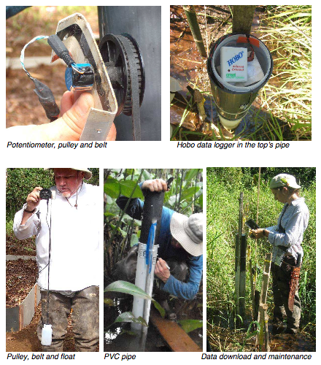
Notes:
The Natural Resource Conservation Service

Slide 11
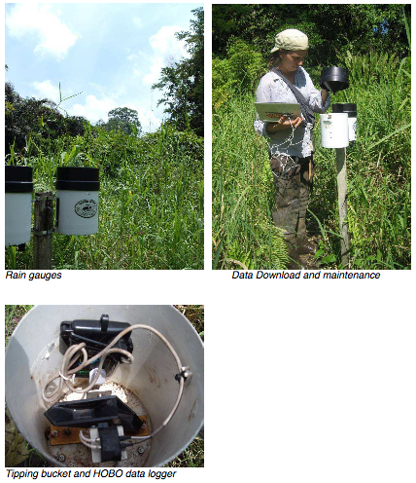
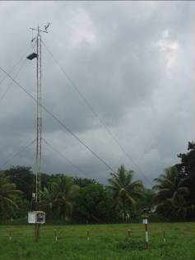
EARTH weather station
Notes:
The Natural Resource Conservation Service

Slide 12
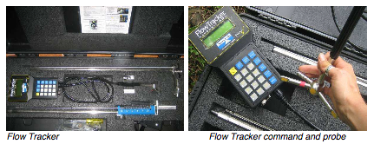
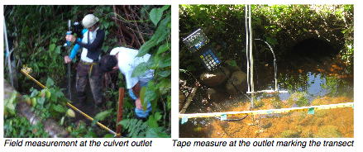
Notes:
The Natural Resource Conservation Service

Slide 13
1.2.2 Water budget
dS = I – O = P + RO – ETP – Q
  dS = change in water volume over an interval of time is the difference between the inflow and the outflow
  I= Inputs= precipitation (P) and runoff (RO)
  O= Outputs= evapotranspiration (ETP) and outflow (Q)
Daily volume [m³]:
  P and ETP referred to the most frequent surface water area (1.56 ha)
  RO referred to the full catchment area (7.58 ha)
Notes:
The Natural Resource Conservation Service

Slide 14
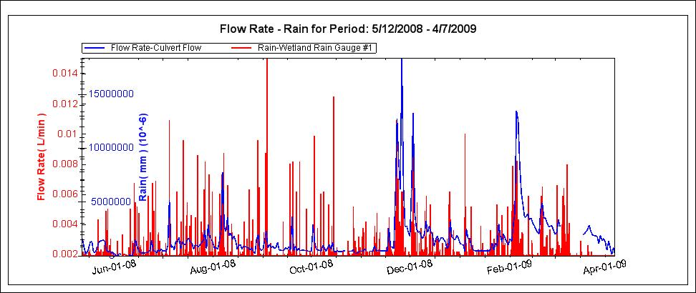
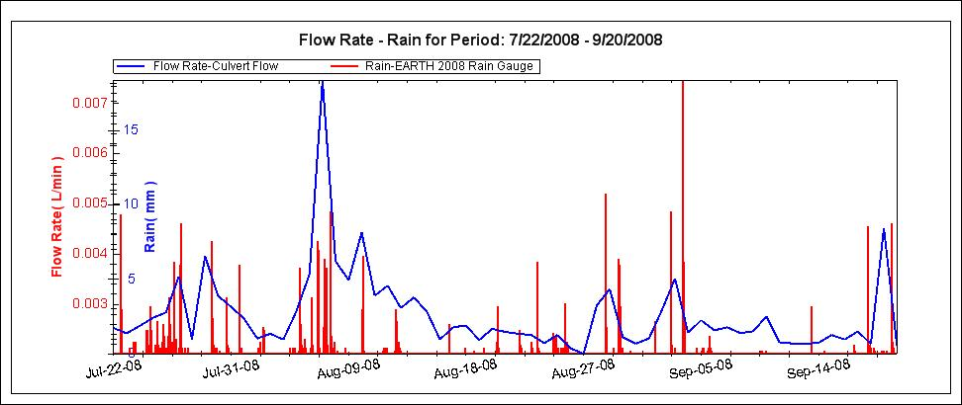
Water budget
Key components:
  Precipitation : « isolated » input
  Outflow : remained as an important output

Slide 15
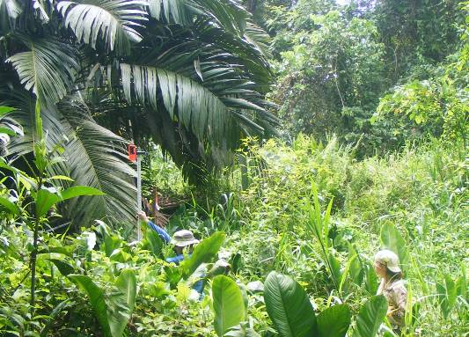
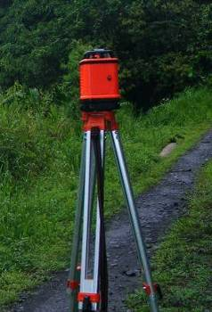
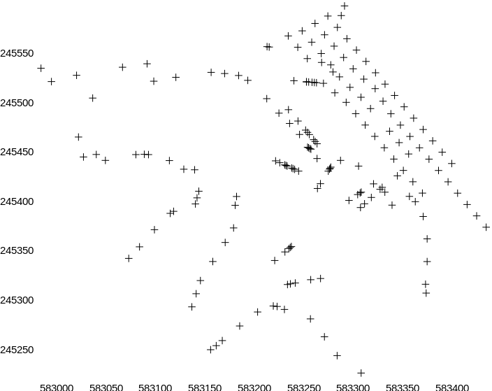
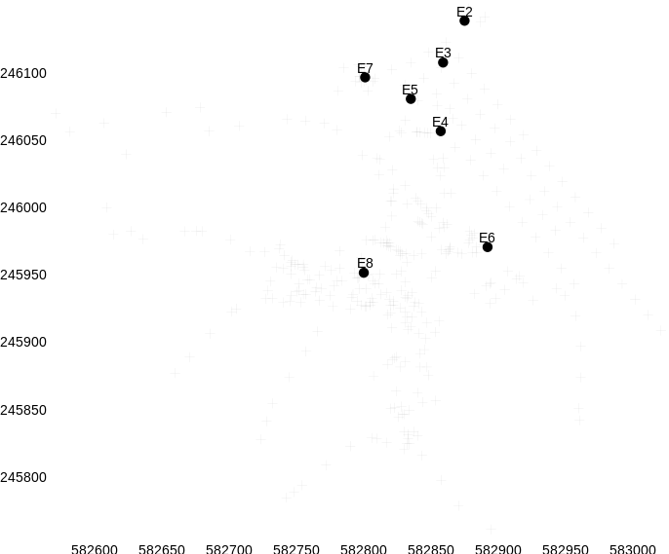
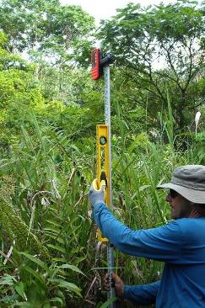
1.2.3 Topographical survey
Survey 2008: 183 data points
  optical level and compas
Survey 2009: 181 data points
  laser and GPS

Slide 16
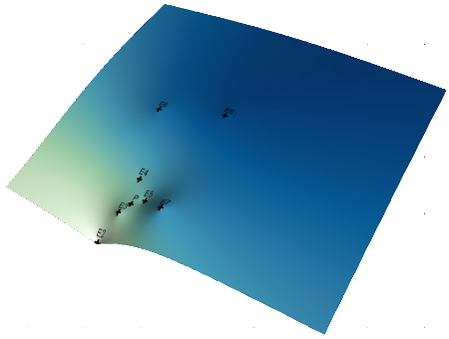
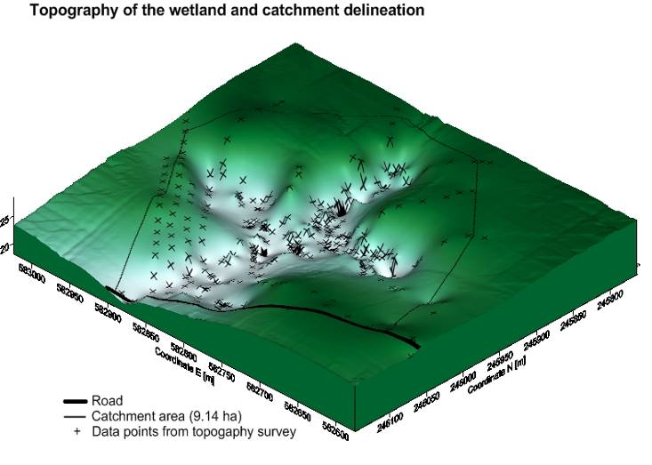
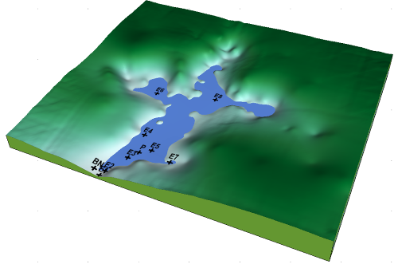
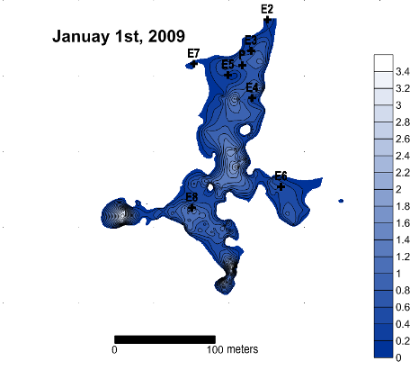
1.2.4 Model of daily volume and area
Data points from the topographical survey used to generate a high-resolution 3D topographical model of the catchment area
Daily and weekly average of the water stages to generate a water surface grid
-
Water surface elevation

Slide 17
1.3 Results

Slide 18
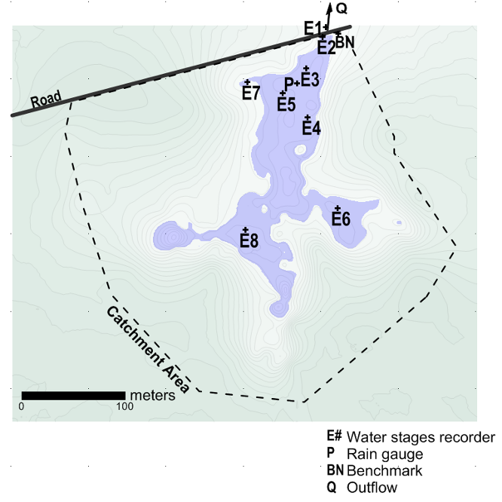
1.3.1 Dataset of the field instrumentation
Spatial:
  Hydraulic gradient
  Stability : branches > main body > outlet
Water surface elevation
Q

Slide 19
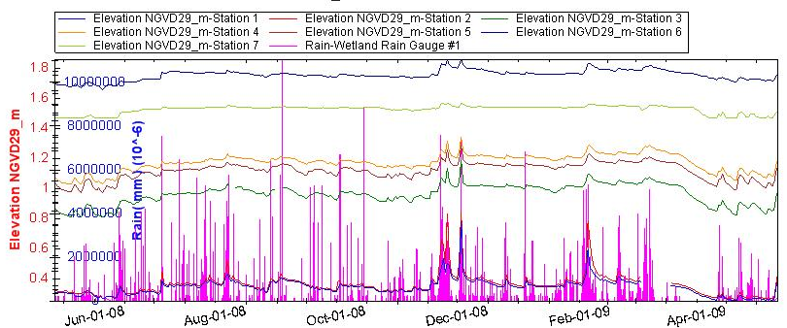
1.3.1 Dataset of the field instrumentation
Temporal:
  Variation : noticeable for dry/wet events
  of successive days (>3)

Slide 20
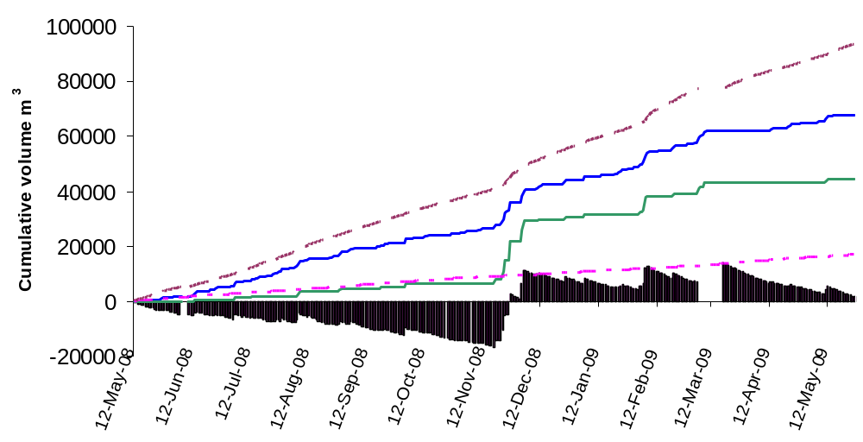
1.3.2 Water budget
Components :
  Inputs: precipitation P and runoff RO
  Outputs: evapotranspiration ETP and outflow Q
Storage :
  Negative : mostly outflow
  Positive : runoff contribution
Q
P
RO
ETP
Balance

Slide 21
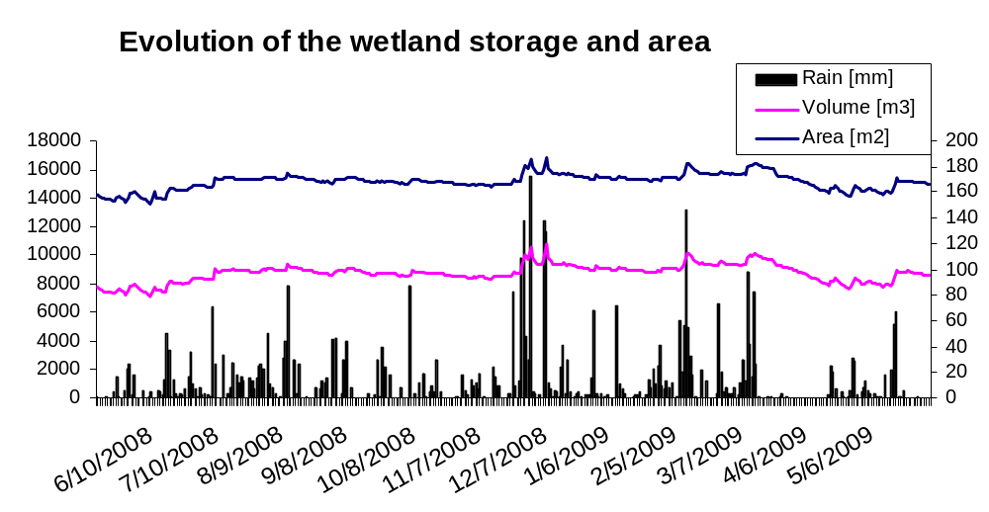
1.3.3 Daily volume and area (1/5)
Yearly: stability and auto-regulation of the system
Inter-annual: isolated area/storage variation correspond to prolonged wet/dry condition

Slide 22
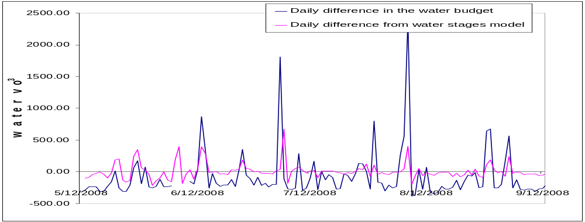
1.3.3 Comparison of volumes (2/5)
Same trends (ρ =0.463, V_{model} = 0.133*V_{budget} + 2.854)
Volumes from water budget have higher isolated peaks :
  Outflow submerged
  Additional input or output (subsurface flow, leakage, runoff estimation…)

Slide 23
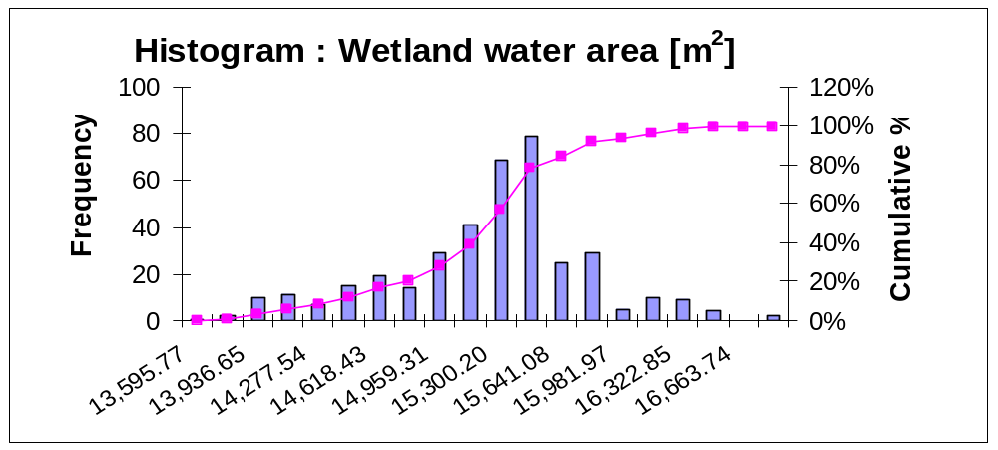
1.3.3 Daily volume and area (3/5)
Frequency distribution of the daily water area
CI_{95%}

Slide 24
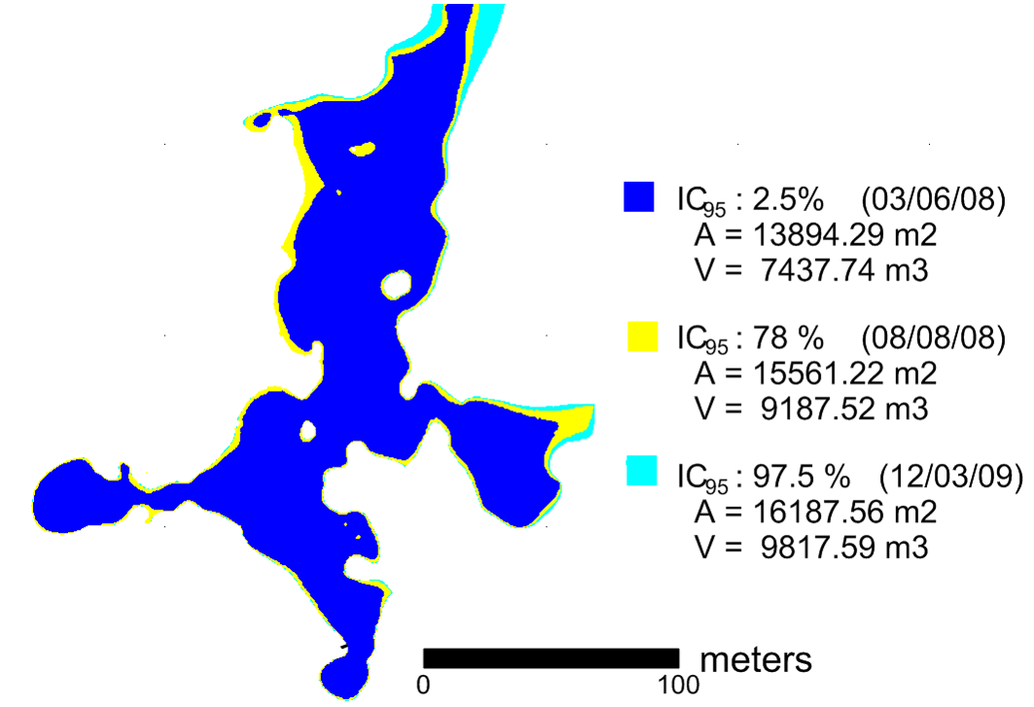
1.3.3 Flooding variation (4/5)
Water surfaces representing:
  The most frequent flooded area
  The lower and upper boundary of the 95% confidence interval of the frequency distribution

Slide 25
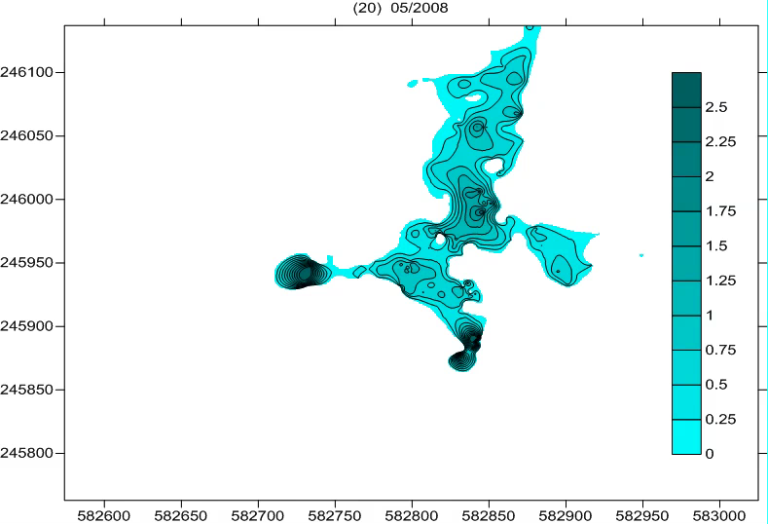
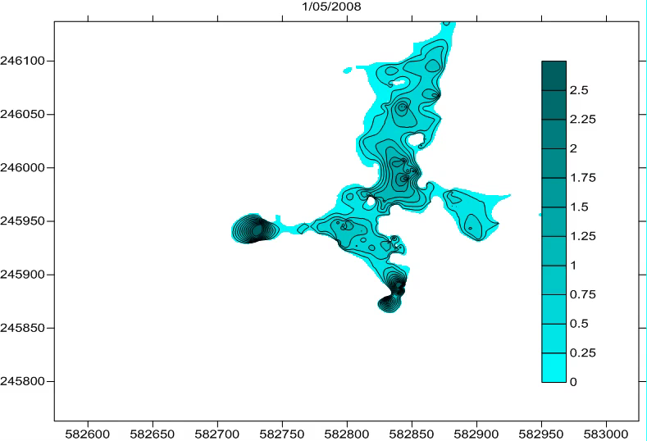
1.3.3 Water depth variation (5/5)
Small flooding variation :
  Difference in the 95% confidence interval: 16.5%
Internal variation of water depth, variation of storage
  Difference in the 95% confidence interval: 24.2%
  ➔ Weekly and daily animation…
Notes:
Small flooding variation :
Middle-lower : 10.7%
Middle-Upper : 3.9%
Upper-Lower : 16.5%
Internal variation of water depth, variation of storage :
Middle-lower : 19.1%
Middle-Upper : 6.4%
Upper-Lower : 24.2%

Slide 26
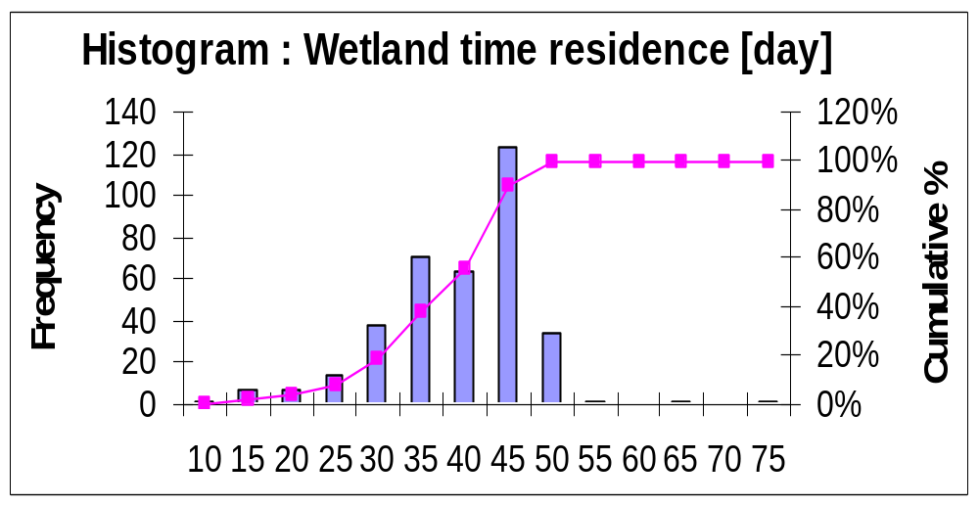
1.3.4 Water quality information
Water time residence in the wetland: Tr = Q / V
…
CI_{95%}
Notes:
Area based first order k-C*model

Slide 27
1.3.4 Water quality information
Natural potential of the quality function with k-C* Model (estimated treatment wetland performance, Kadlec and Knight, 1995) :
C₂ = C*+(C₁-C*)exp(-kA/0.0365Q)
C₁ = Inlet concentration [mg/L]
C₂ = Outlet concentration [mg/L]
C* = Irreductible background wetland concentation [mg/L]
k = Reduction rate constant [m/yr]
A = Wetland area [m²]
Q = Flow [m³/s]
 | % removal of the initial conc. |  |  |  | Cumulative
Tr [day] | BOD₅ | TSS | TN | TP | Frequ %
5-10 | 68.4 | 98.0 | 61.8 | 34.4 | 0.28%
10-15 | 81.5 | 98.0 | 75.9 | 46.7 | 1.66%
15-20 | 91.9 | 98.0 | 88.6 | 62.5 | 4.16%
20-25 | 95.3 | 98.0 | 93.5 | 72.0 | 5.82%
25-30 | 96.8 | 98.0 | 95.9 | 79.0 | 13.57%
30-35 | 97.5 | 98.0 | 97.2 | 84.2 | 28.81%
35-40 | 97.8 | 98.0 | 97.9 | 88.4 | 47.37%
40-45 | 97.9 | 98.0 | 98.2 | 91.6 | 66.48%
45-50 | 97.9 | 98.0 | 98.3 | 93.0 | 97.23%
50-60 | 98.0 | 98.0 | 98.4 | 96.0 | 99.45%
60-70 | 98.0 | 98.0 | 98.5 | 97.7 | 99.72%
70-75 | 98.0 | 98.0 | 98.5 | 98.5 | 100.00%
…
= IC_{95%}
Notes:
Area based first order k-C*model

Slide 28
1.4 Conclusions
System stable and auto-regulated
Small daily variation in flooding frequency and storage
  Frequency and duration of the variation in flooded area is not a decisive factor for a vegetation type
  Good water quality potential
Water balance can be improved
  Driven by precipitation and the outflow
  Additional parameters ?
  Estimated runoff

Slide 29
Part 2: Multi-Tracer Field Study

Slide 30
2.1 Introduction and objectives
Wetland: natural potential of the water to remove pollutant and improve water quality
Multi-tracer study:
  1. To explore the hydraulic characteristics of the wetland (velocities, pathways, residence time distribution and water mixing);
  2. To assess the feasibility of using Sulfure Hexafluoride as a surface tracer compared to bromide under humid tropical and slow flow conditions.

Slide 31
2.2 Material and Methods

Slide 32
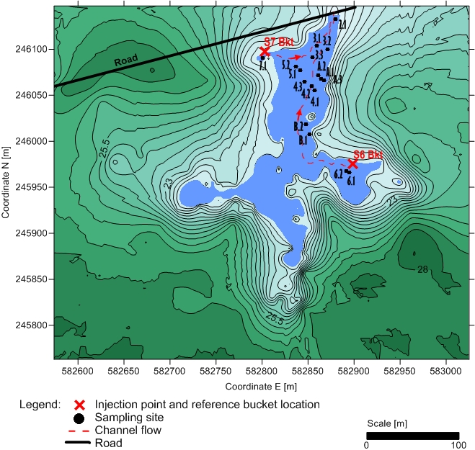
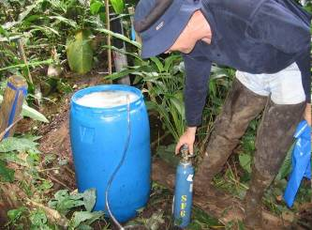
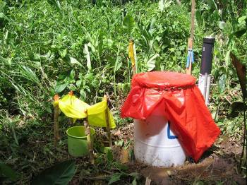
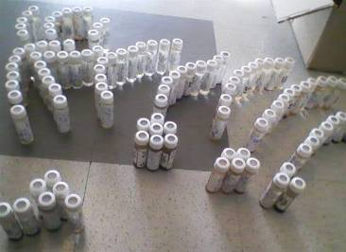
2.2.1 Preparation, injection and sampling
Field work in 2008:
  Tracer preparation in the field
  Reference buckets at each site
  Injection from opposite branches
  Daily sampling (18 sites, 3 weeks)

Slide 33
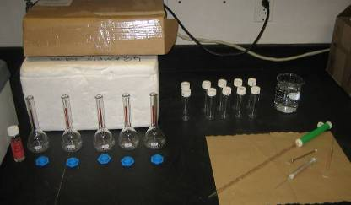
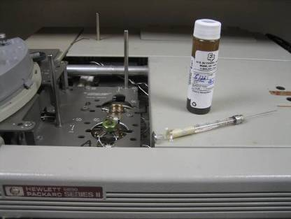
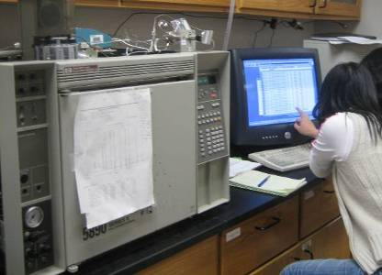
2.2.2 Sample analysis: SF₆
Sulfur Hexafluoride (SF₆):
  Non conservative gas
  Low solubility in water
  Natural low concentration (10⁻¹⁵ M) and detectable in small amount (10⁻¹⁶ M)
Gas chromatograph with electron capture detector (GC/ECD)
  Daily calibration curve
  Method detection limit: 10⁻⁶
  Manual injection and identification

Slide 34
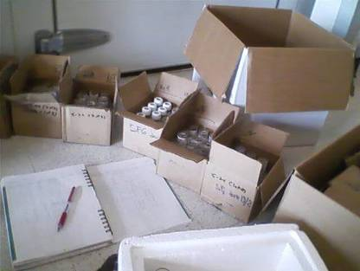
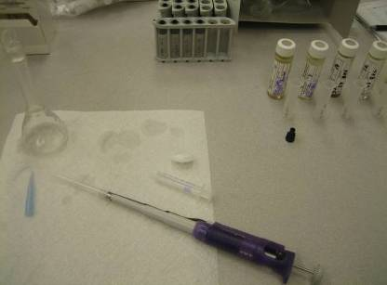
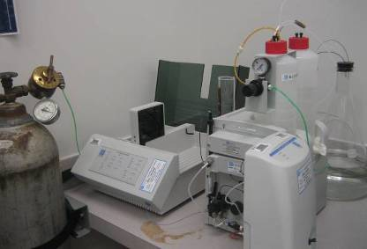
2.2.3 Sample analysis: Br ⁻
Bromide (Br⁻):
  Salt
  Conservative and robust
  High dilution rate in water
High Pressure Liquid Chromatography (HPLC) with electrochemical detection
  Calibration curve before each samples set
  Method detection limit: 10⁻¹⁰
  Direct calculation of the peak concentration

Slide 35
2.3 Results

Slide 36
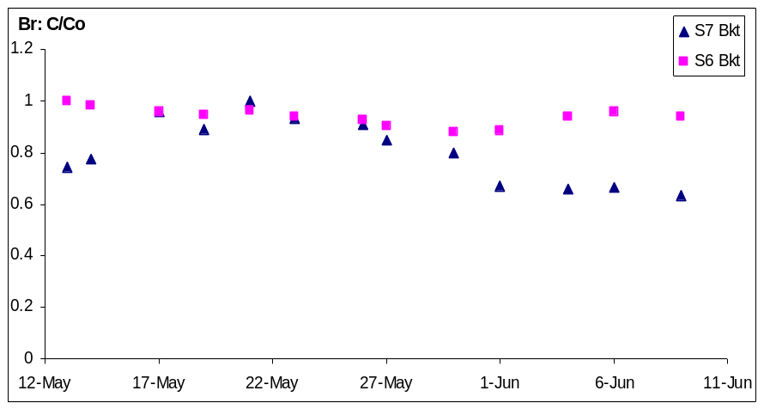
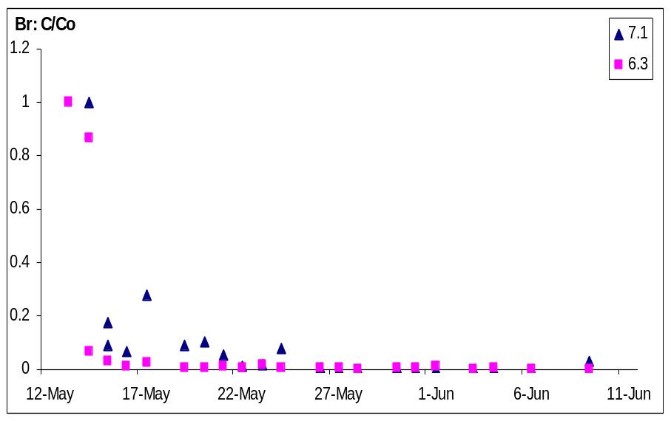
2.3.1 Bromide concentration by site (1/2)
Reference buckets: stable [Br⁻]
Injection sites (6 & 7): quick decrease (until background [Br⁻])

Slide 37
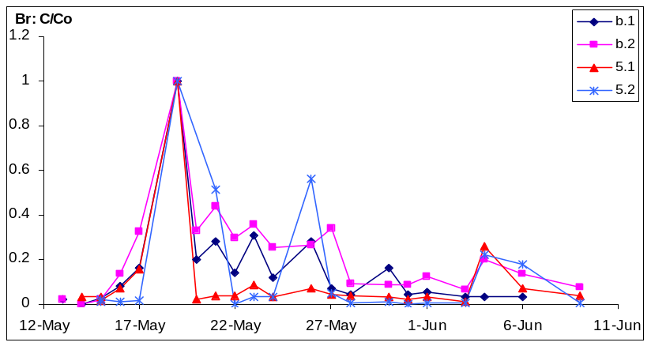
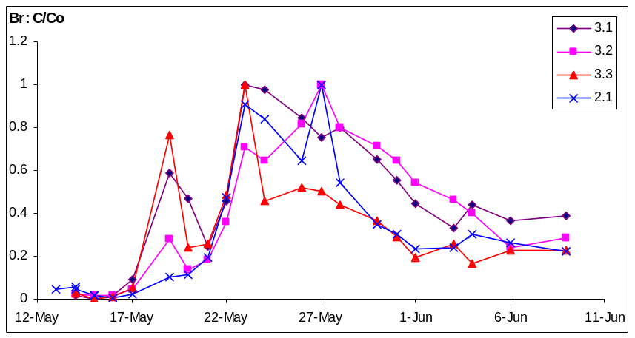
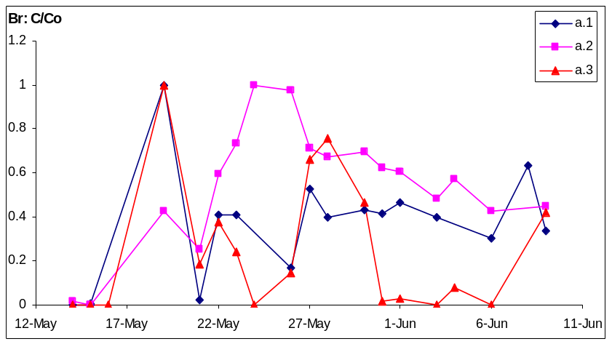
2.3.1 Bromide concentration by site (2/2)
Low [Br⁻] with peak→ tracer cloud passing:
  Sites A & 5: One peak
  Sites 4, 3 & 2: Two peaks
  Site B: edges effect, slow flow and mixing

Slide 38
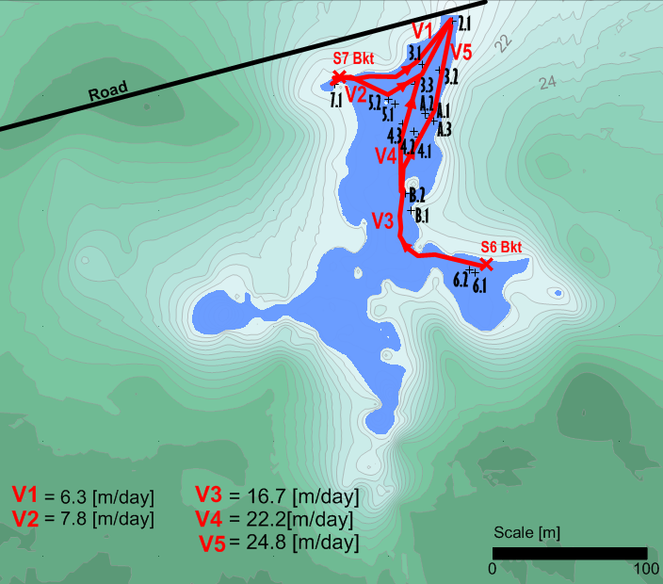
2.3.2 Velocities and preferential chanels
Velocity estimation [m/day]:
V = distance from injection site / time to peak from injection day
  S6: Longer pathway, faster velocities (V central < V edges)
  S7: Shorter pathway, slower velocities (V central > V edges)

Slide 39



2.3.3 Br ⁻ comparison with SF₆
No significant [SF₆] peak, low and fairly stable concentrations
Similar fast decrease of [SF₆] from reference bucket and at injection sites:
  Too fast volatilization during transport

Slide 40
2.4 Conclusions
Bromide: successful tracer in shallow and slow surface flow in humid and tropical climate
Sulfur Hexafluoride: not adapted to these conditions
Average flow velocities (7-26 m/day) in the same range than velocities calculated with the time residence and the longest path along the wetland (6-11 m/day)
Time to peak and distance between sites gave preliminary analysis to study the hydraulic caracteristics of the wetland (flowpaths, velocities and preferential chanels)

Slide 41
Summary – Take home
The small wetland proved stable and auto-regulated
Small daily variation in flooding frequency and storage
Residence times (20-50 days) obtained for this wetland sindicate good water quality potential with expected removal of common pollutants (BOD, TSS, TN, TP) between 72-98% through the year.
Hydrological and tracer study methods provided consistent average flow velocities (7-26 m/day) in the wetlands through the year.
Time to peak and distance between sites gave preliminary analysis to study the hydraulic caracteristics of the wetland (flowpaths, velocities and preferential chanels) and indicates that the wetland is heterogeneous with fast and slow flow areas.
These findings support the important role that small and ubiquitous wetlands in the humid tropics can play in the environmental quality of these areas

Slide 42




Future steps
Improvement of rainfall/runoff estimates with field plot
Inverse modeling of tracer breakthrough curve

Slide 43

Thank you for your attention !
Questions ?

